Slide 1
Retrieval augmented generation & LLM agents
From: https://web.stanford.edu/~jurafsky/slp3/

Slide 2
Retrieval-Augmented Generation

Slide 3
How to answer factual questions like
Where is the Louvre Museum located?
Where does the energy in a nuclear explosion come from?

Slide 4
Just prompt an LLM!
LLMs seem to store facts in the connections in their feedforward layers!

Slide 5
But there are issues!

Slide 6
LLMs Hallucinate
Hallucination: a response that is not faithful to the facts of the world.
In the legal domain LLMs were shown to hallucinate up to 88% of the time!
Dahl et al. (2024)

Slide 7
Can't use Proprietary Data
People need to ask questions about:
personal email.
healthcare applications to medical records.
internal corporate documents
legal documents discovery
What does our course syllabus say about the final project?

Slide 8
Can't Handle Dynamic Data
LLMs can't answer questions about rapidly changing information
Things that happened last week
In general, data shifts over time

Slide 9
Solution: RAG
Retrieval-Augmented Generation
Use IR to retrieve documents from some collection
Then use LLM to generate an answer conditioned on the documents

Slide 10
Retrieval Augmented Generation (RAG)

Slide 11
Basic RAG
Given a document collection D and a user query q
Call a retriever to return top k passages
Create a prompt that includes q and the passages
Call an LLM with the prompt

Slide 13
LLM agents
From: https://newsletter.maartengrootendorst.com/p/a-visual-guide-to-llm-agents

Slide 14
Agents
An agent is anything that can be viewed as perceiving its environment through sensors and acting upon that environment through actuators. — Russell & Norvig, AI: A Modern Approach (2016)

Slide 15
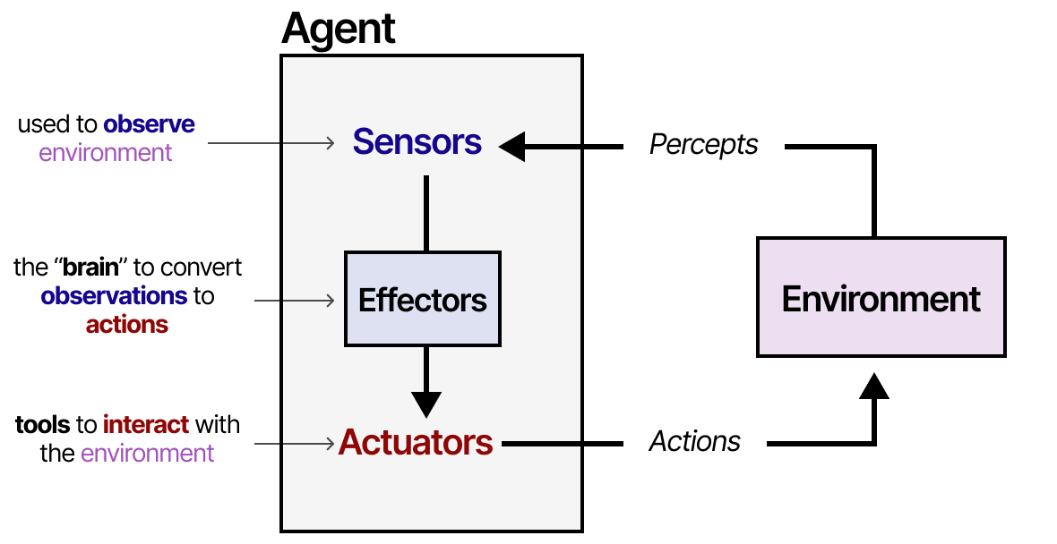
Agents

Slide 16
LLM agents
An LLM agent is an LLM-based system that can choose actions, call tools, observe results, and iteratively decide what to do next.
User: "Compare this year's project rules with last year's."
Agent:
1. Search current syllabus
2. Search old syllabus
3. Retrieve relevant chunks
4. Compare differences
5. Produce answer with evidence

Slide 17
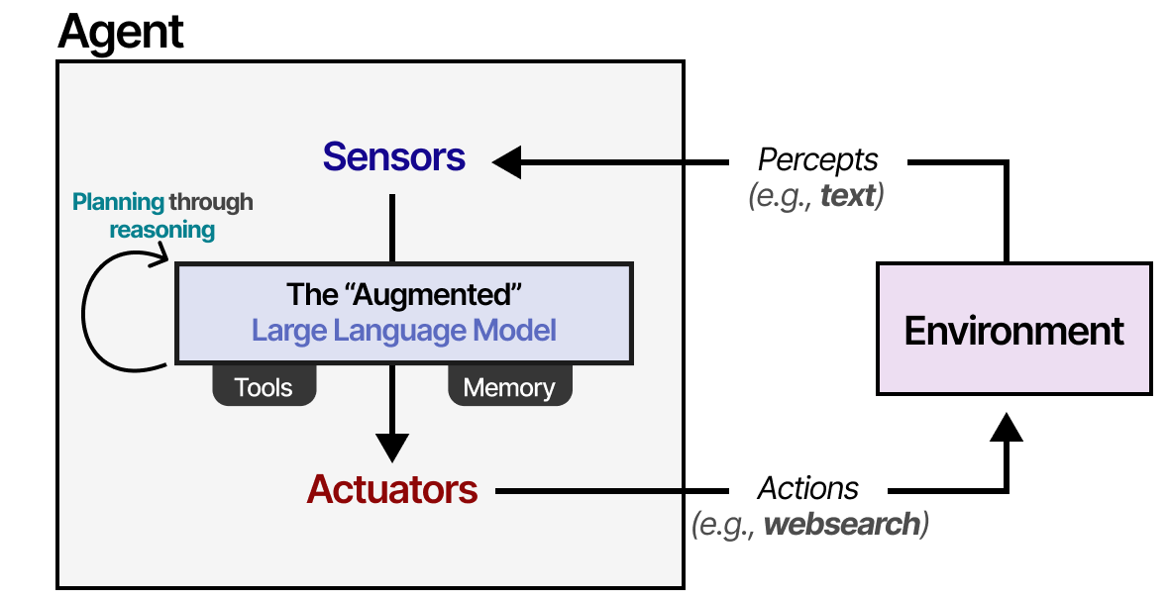
LLM agent

Slide 18
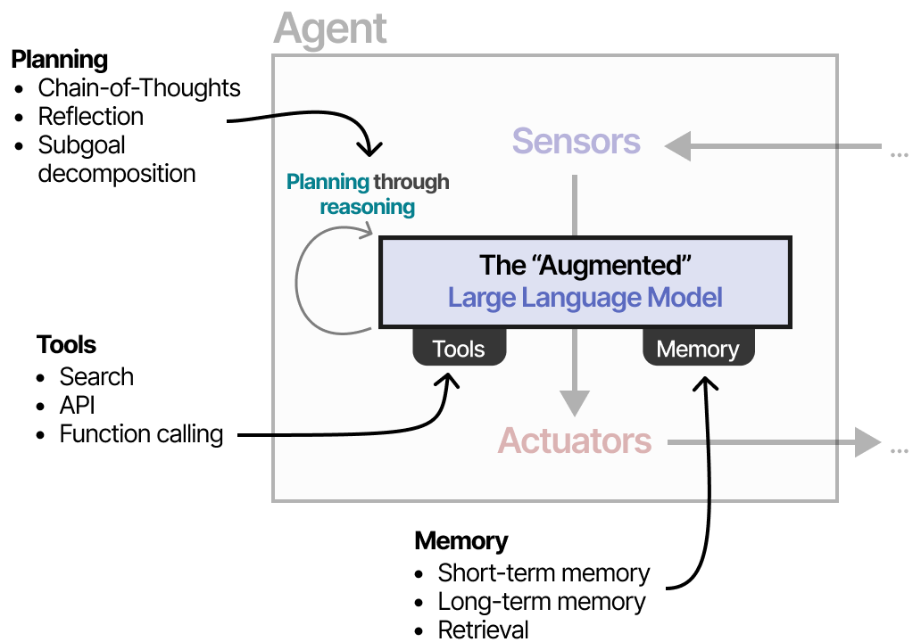

Slide 19
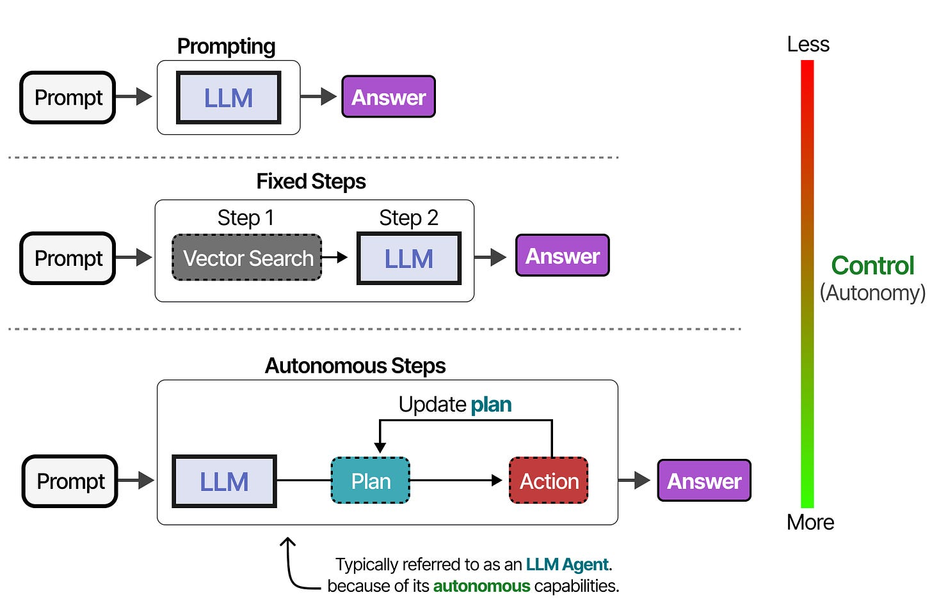

Slide 20
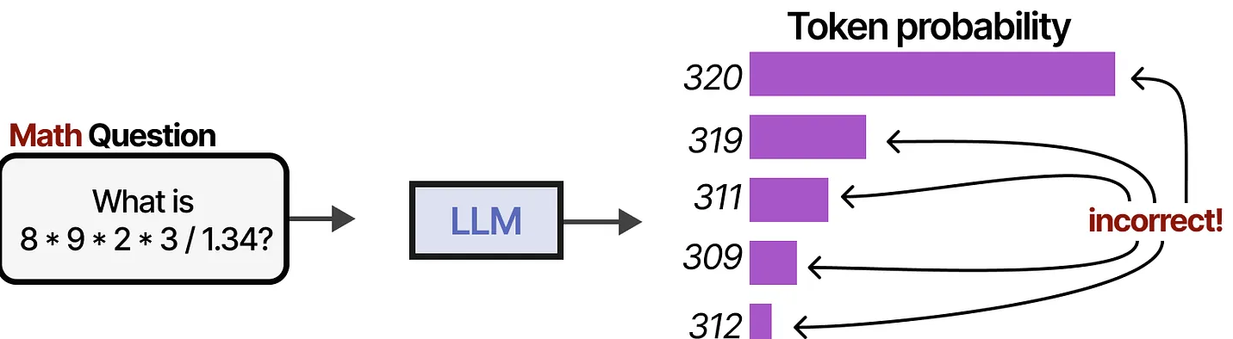
Augmenting LLMs

Slide 21
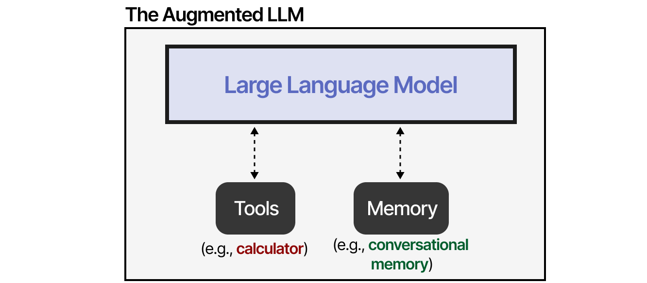
Augmenting LLMs

Slide 22
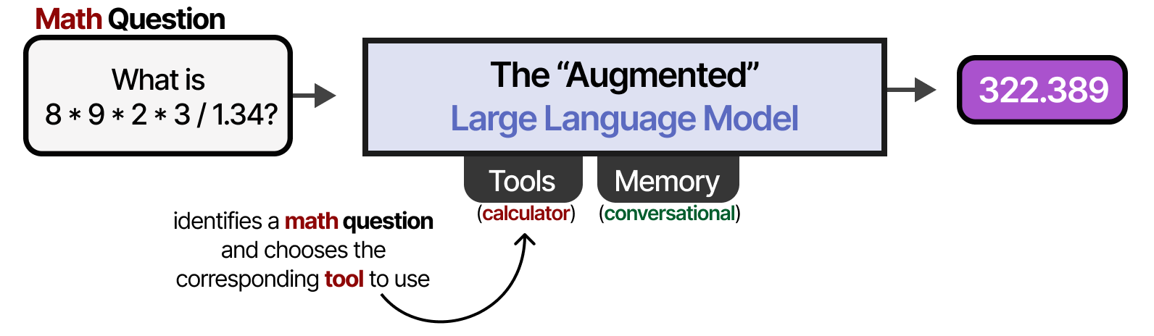
Choosing tools

Slide 24
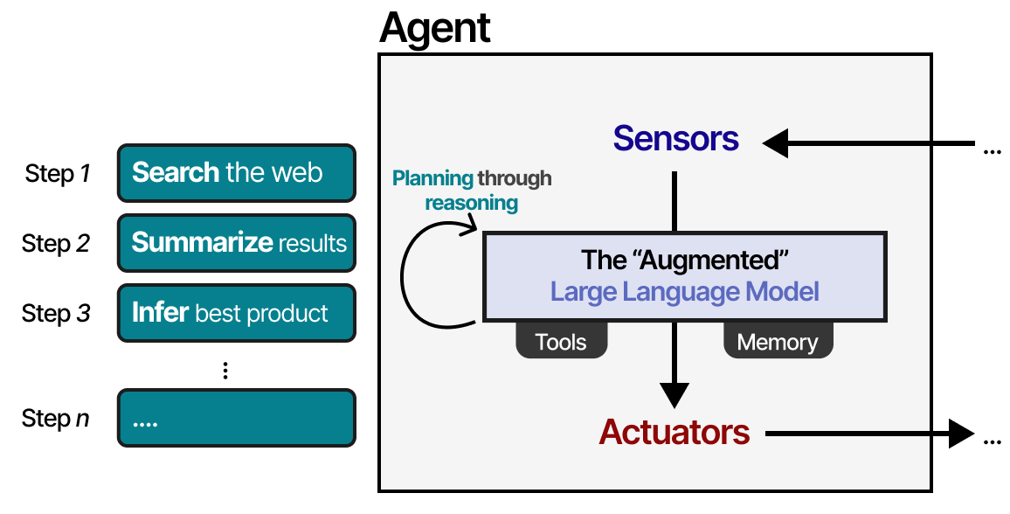
Planning through reasoning

Slide 25
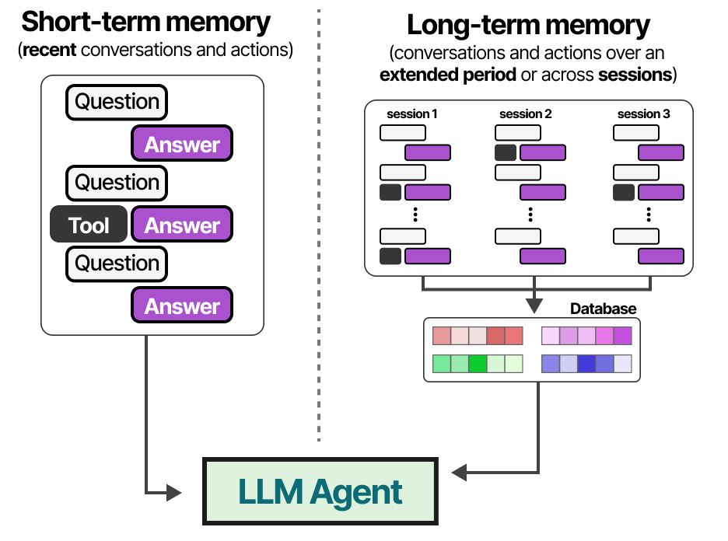
Memory

Slide 26
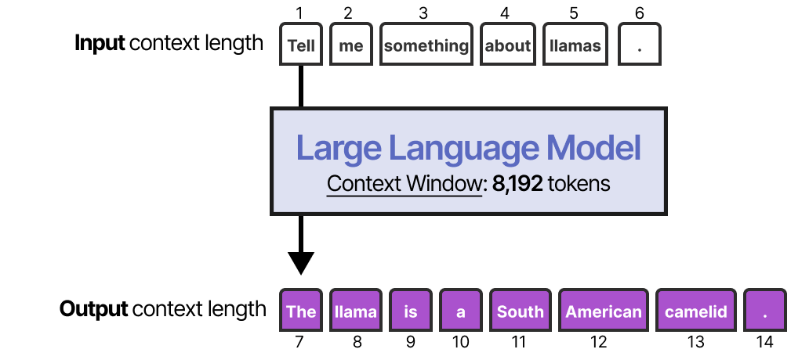
Using context of LLM as memory

Slide 27
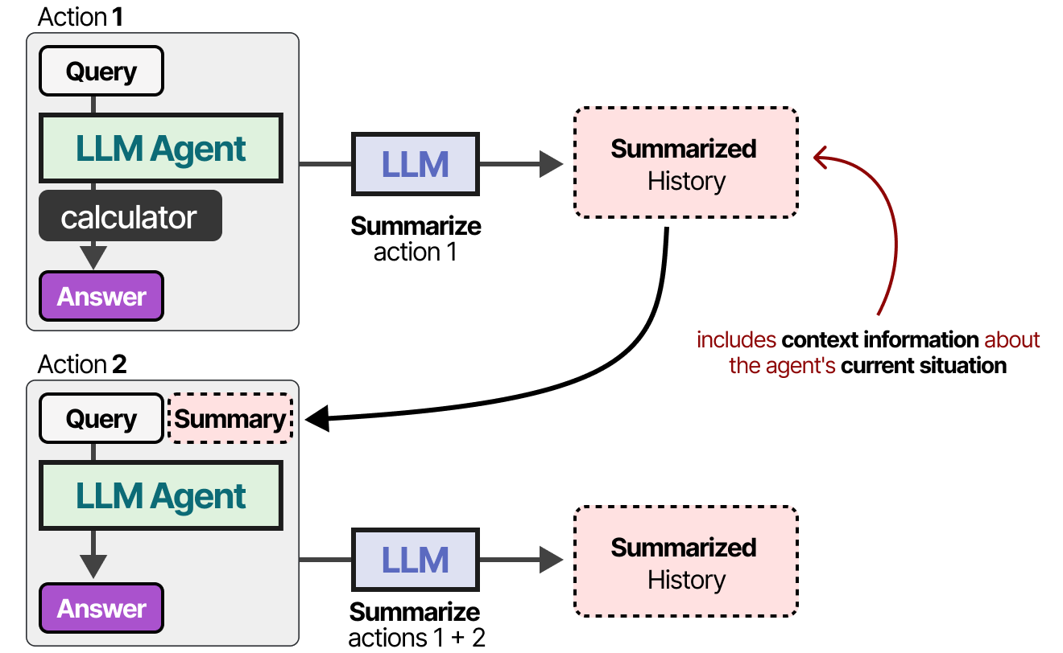
Summarizing context

Slide 28
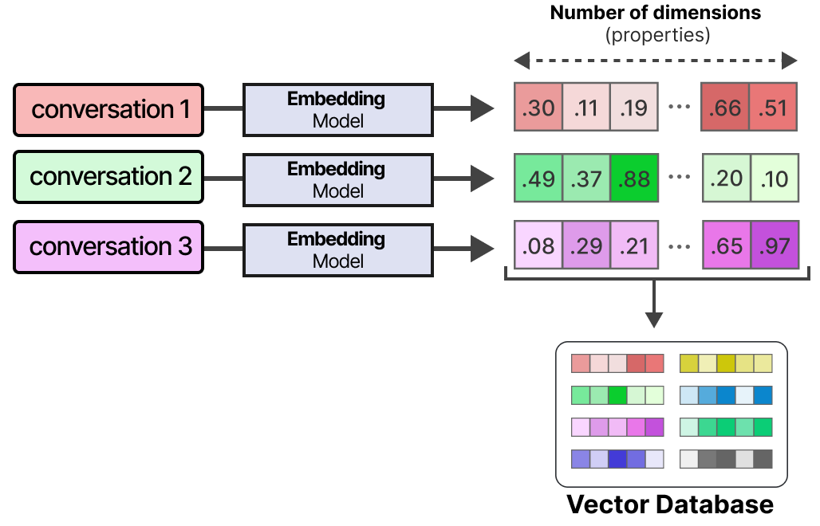
Long-term memory: using RAG

Slide 29
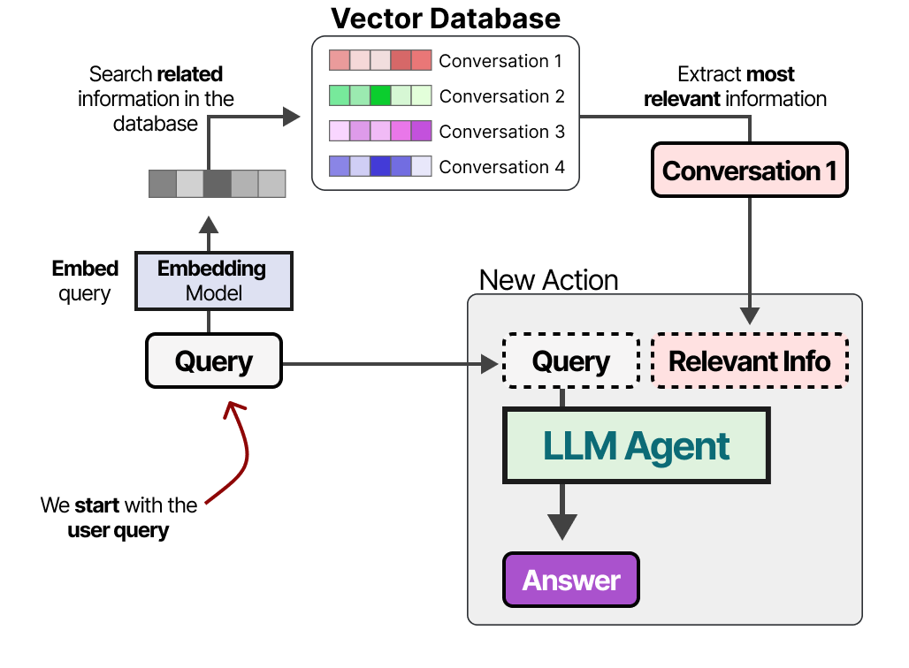
Long-term memory: using RAG

Slide 30

Tools

Slide 31
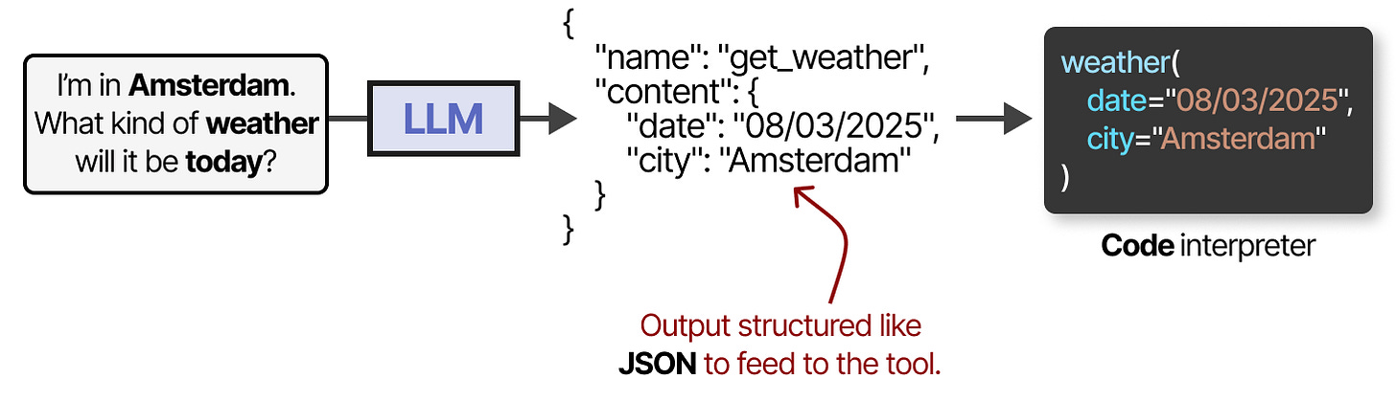
Tools: API calling

Slide 32
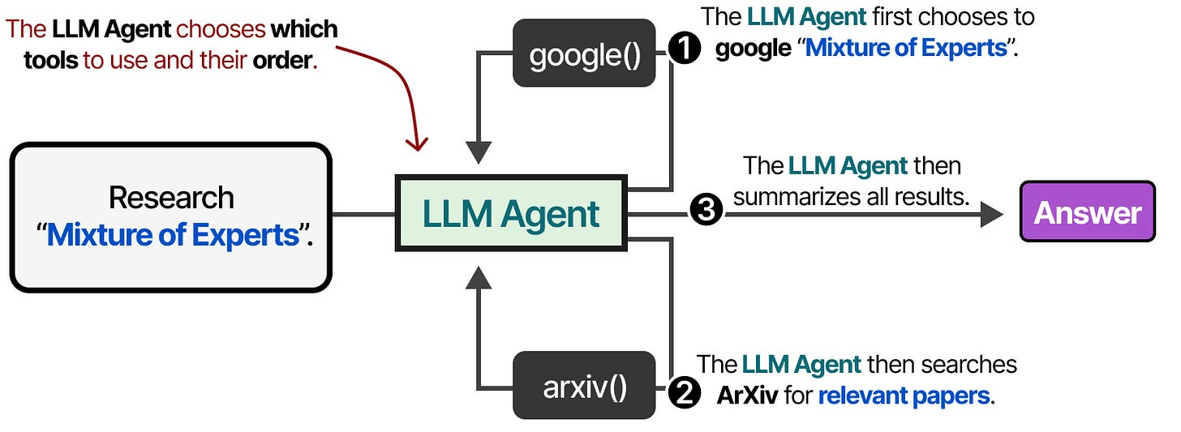
Using multiple tools

Slide 33
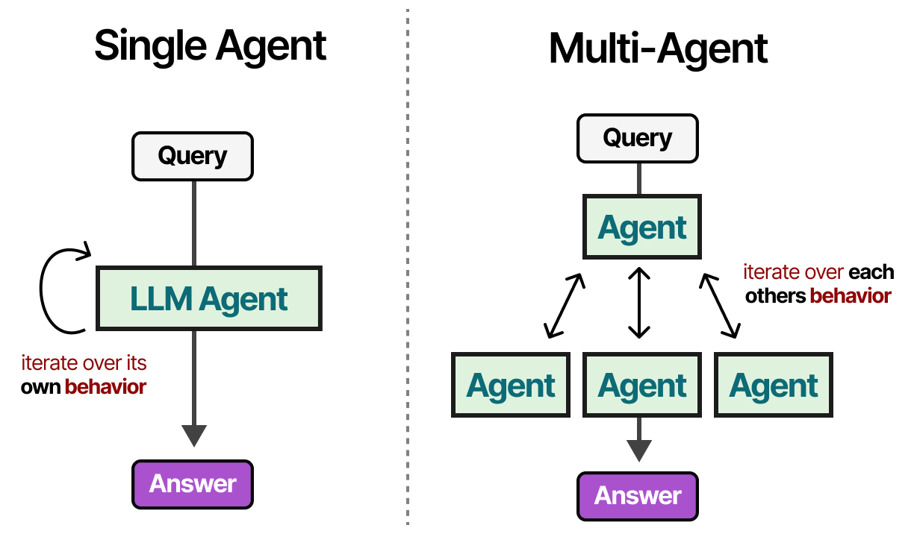

Slide 34
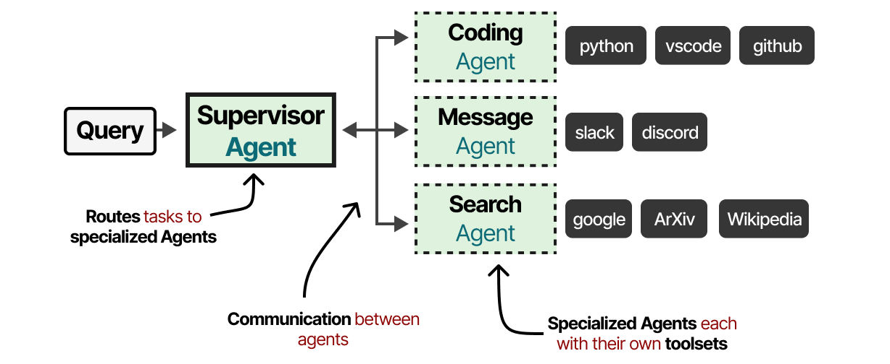

Slide 35
Some critical questions
Did the agent choose the right tool?
Did it call tools unnecessarily?
Did it enter a loop?
Did it expose private data?
Can we audit its intermediate actions?
Is the system deterministic enough for production?

